Slide 1
Natural Language Processing
Mohammad Amin Samadi
Mohammad Sadegh Akhondzadeh

Slide 2
What is Natural Language Processing
A subfield of linguistics, Artificial Intelligence and Cognitive Sciences
An interdisciplinary subject
Aim: To build intelligent computers that can interact with human being like human beings

Slide 3
Why NLP
Huge amounts of data Internet = at least 20 billions pages.
Text data: web sites, blogs, tweets.
Audio data speech.

Slide 4
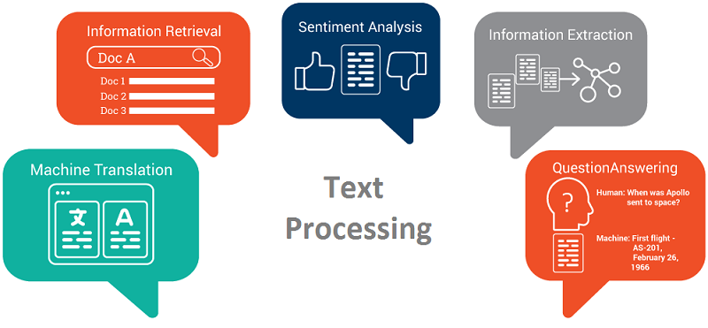
Applications

Slide 5
Why NLP is HARD
Cross Language Problems
Problem of other languages
Ambiguity
Compression
Example sentiment analysis
German:Donaudampfschiffahrtsgesellschaftskapitän (5 “words”)
Chinese: 50,000 different characters.
Japanese: 3 writing systems

Slide 6
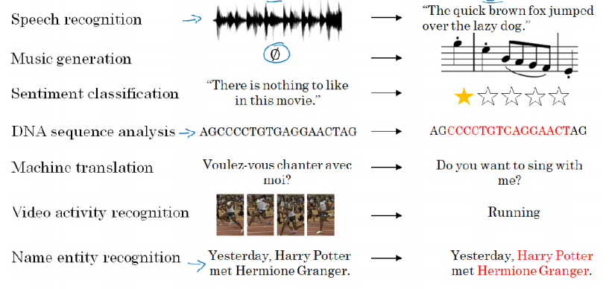
Examples of sequence data

Slide 7
Sequence in Language

Slide 8
Word Representation
How to express words to a computer?

Slide 9
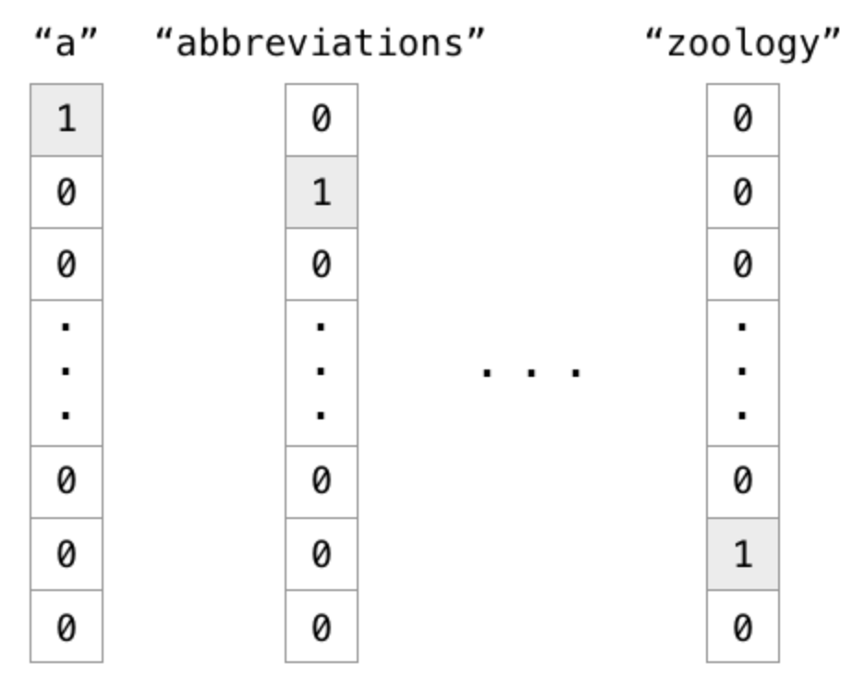
One-hot Representation
Problems :
Meaning relations and similarities ignored
Inefficient Memory consumption
Vector size dependant on vocabulary size

Slide 10
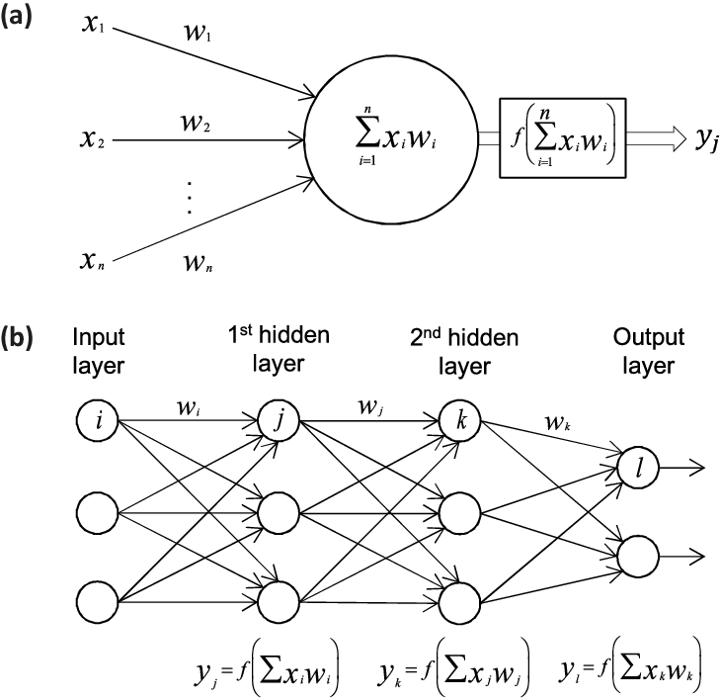
Neural Network
Based on human’s brain and nervous system
Approximates a function from input to output

Slide 11
Word embedding
Featurized representation of words
Each words is embedded to a vector in a 100 or 200 or … dimension space
Learned from large text corpus ( 1-100B words)
We can train it
Download pre-trained
Helps us learn a context with fewer examples

Slide 12
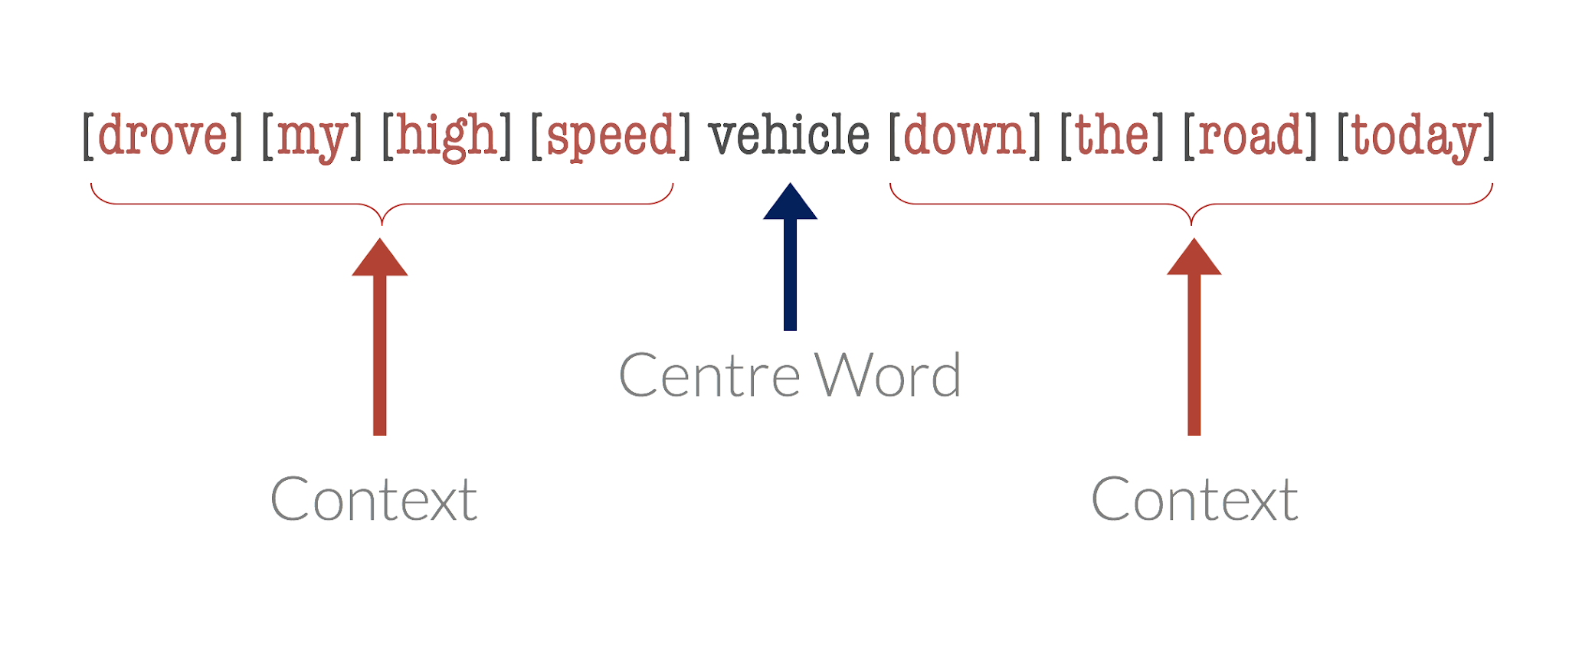

Slide 13
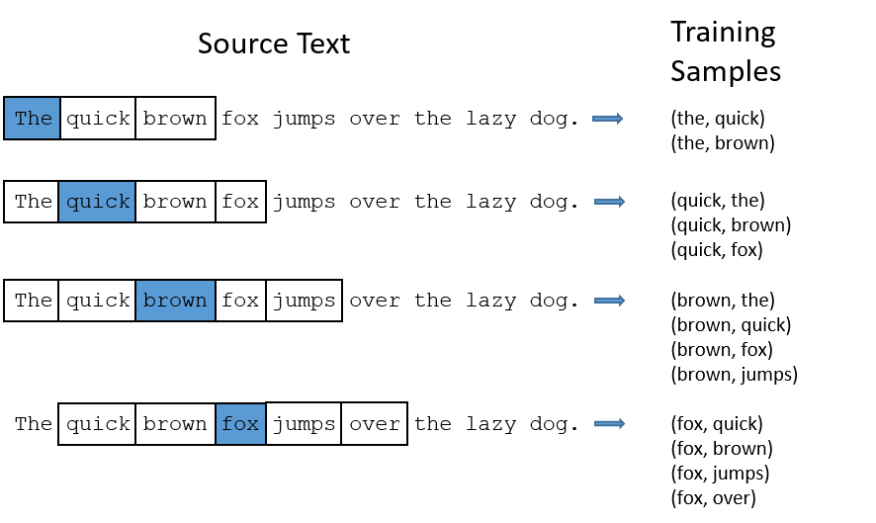
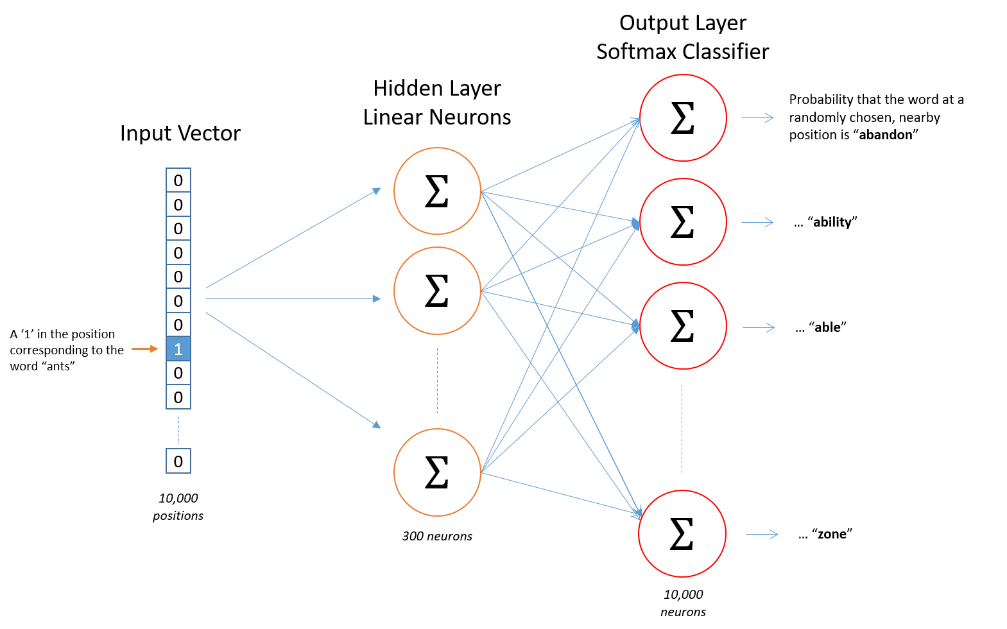
Skip-gram
Fake task explanation
Tries to predict the context based on the center word

Slide 14
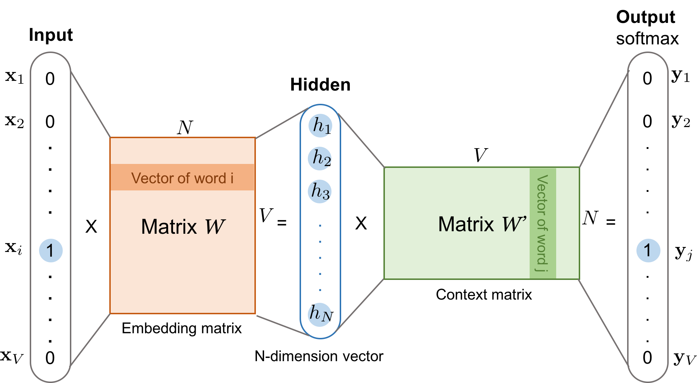
Representation Learning (Skip-gram)

Slide 15
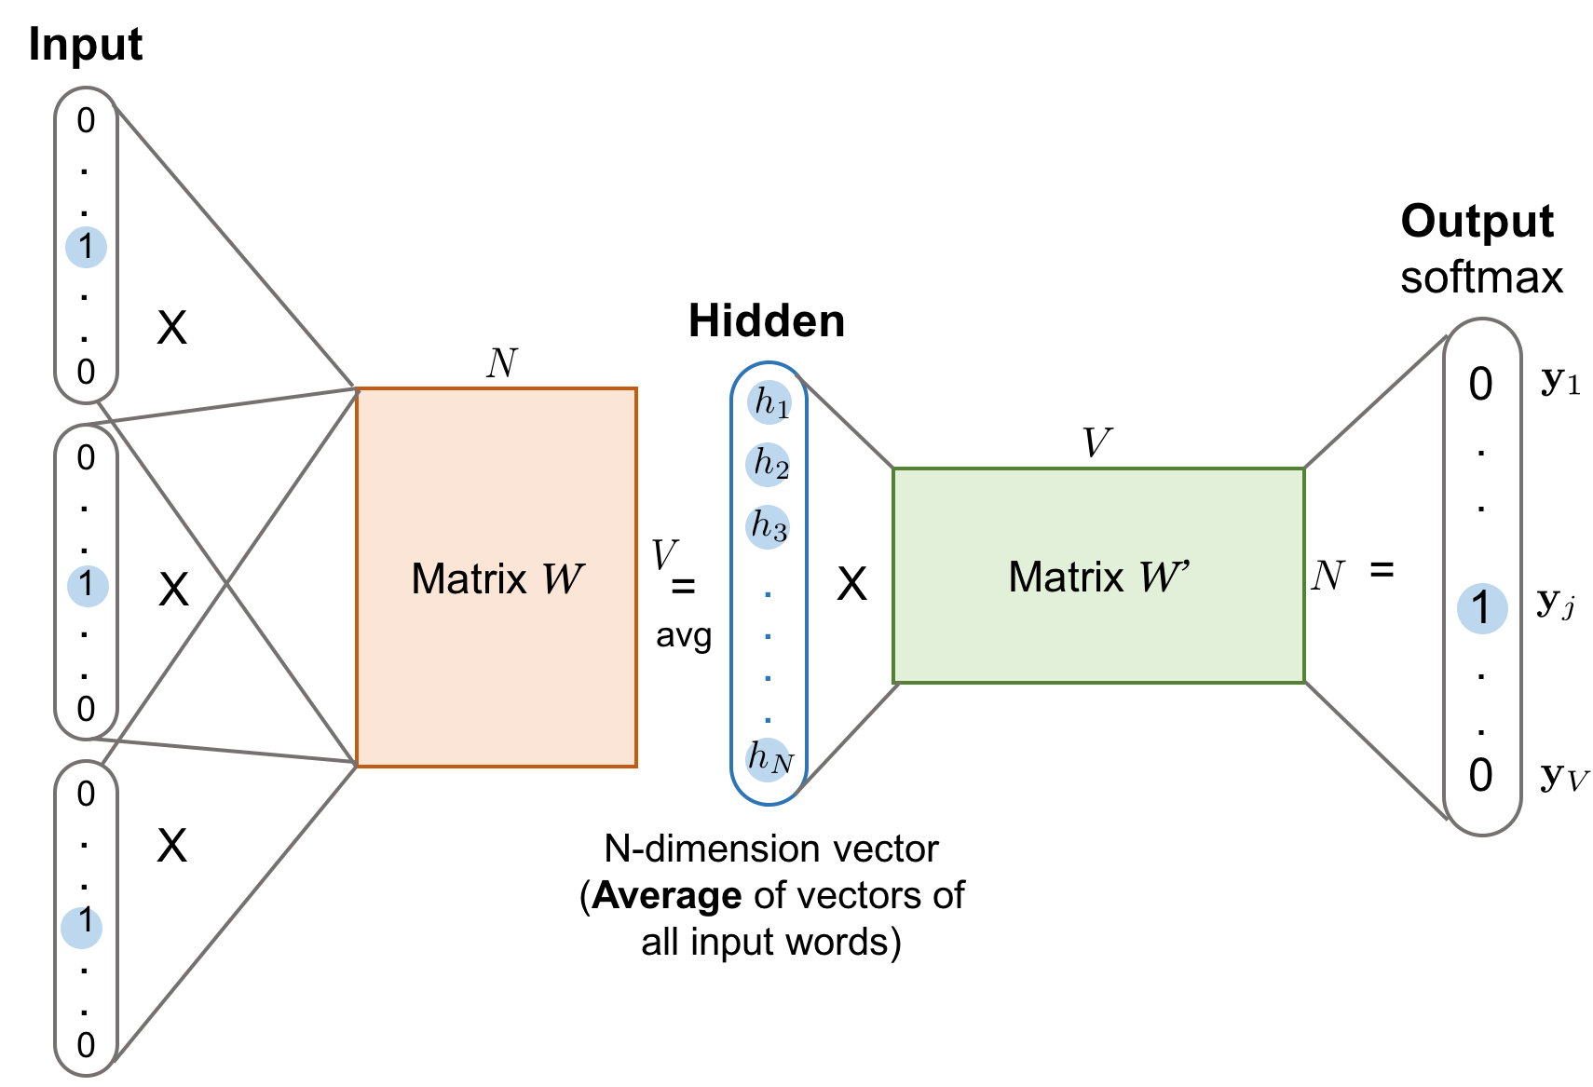
Representation Learning (CBoW)
Tries to predict the center word based on the context

Slide 16
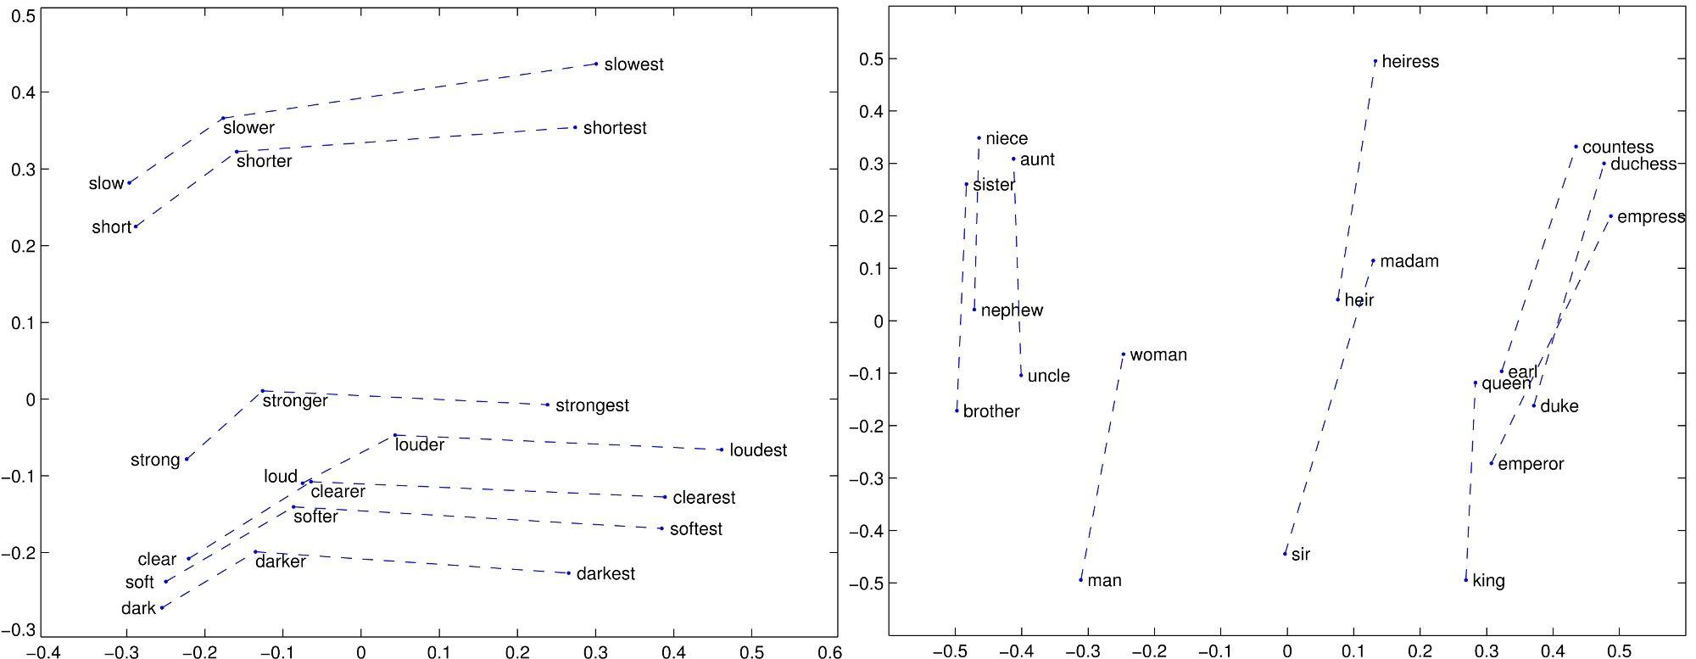
Vector offset
can encode semantic and syntactic relations between words

Slide 17
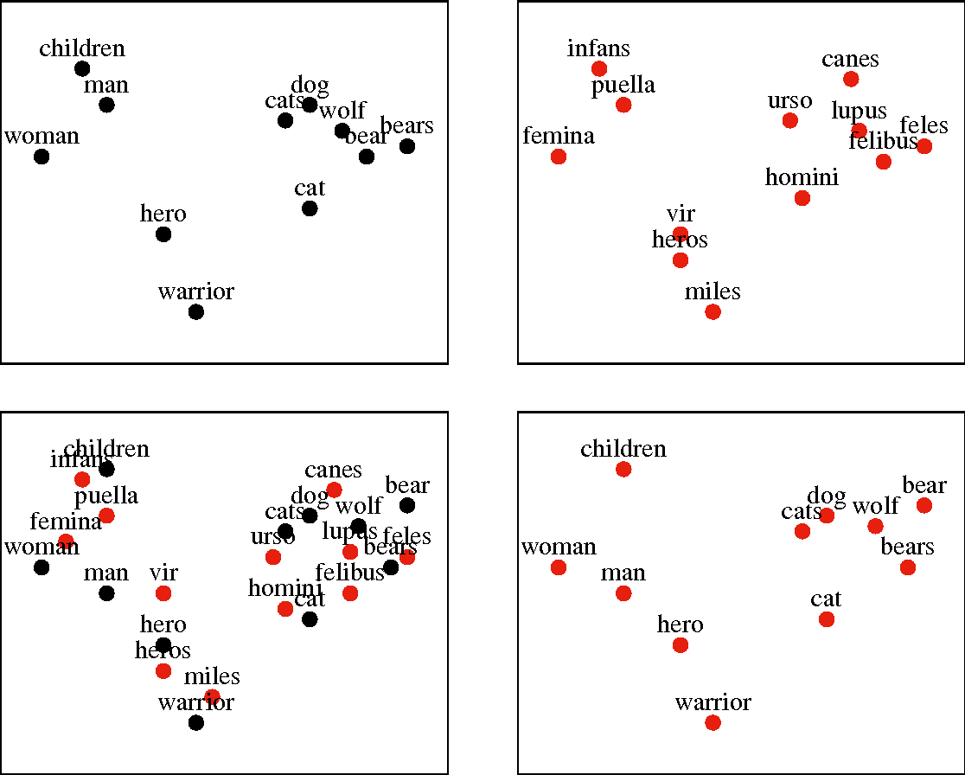
Dimension Reduction

